Slide 1
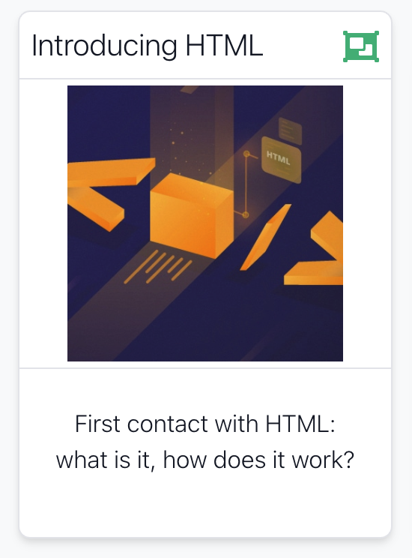

Slide 2
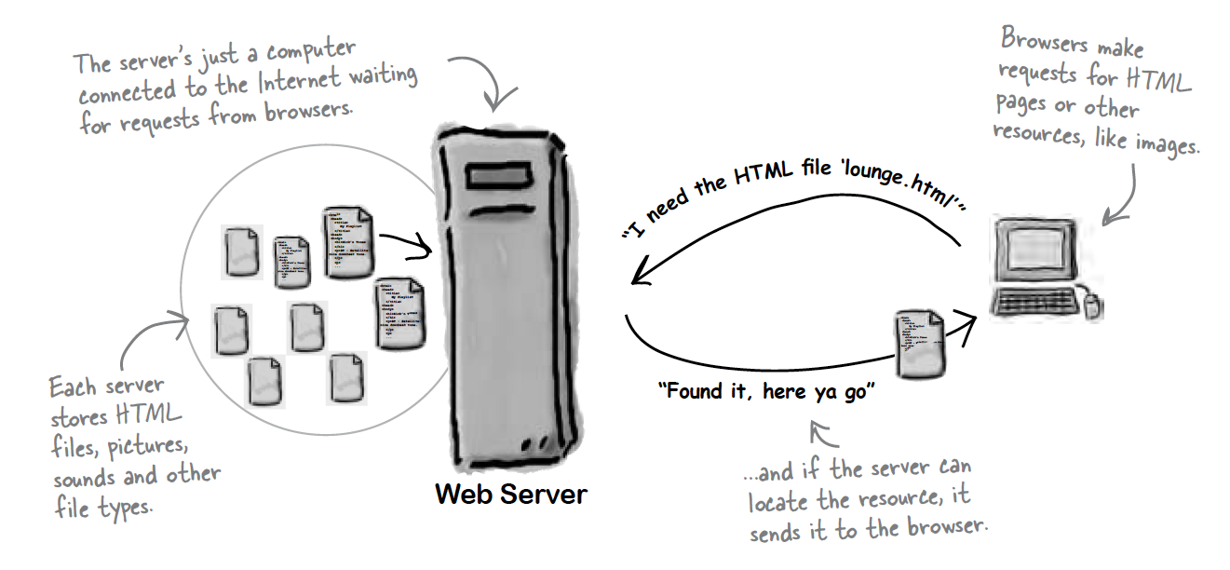
Role of Server

Slide 3
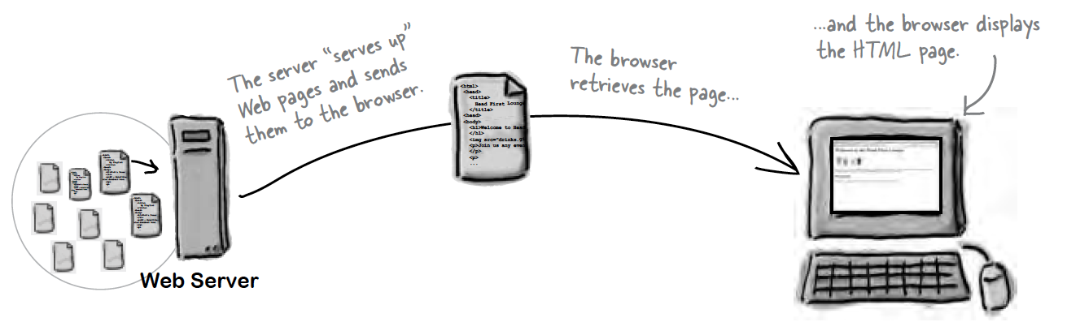
Role of Client

Slide 4
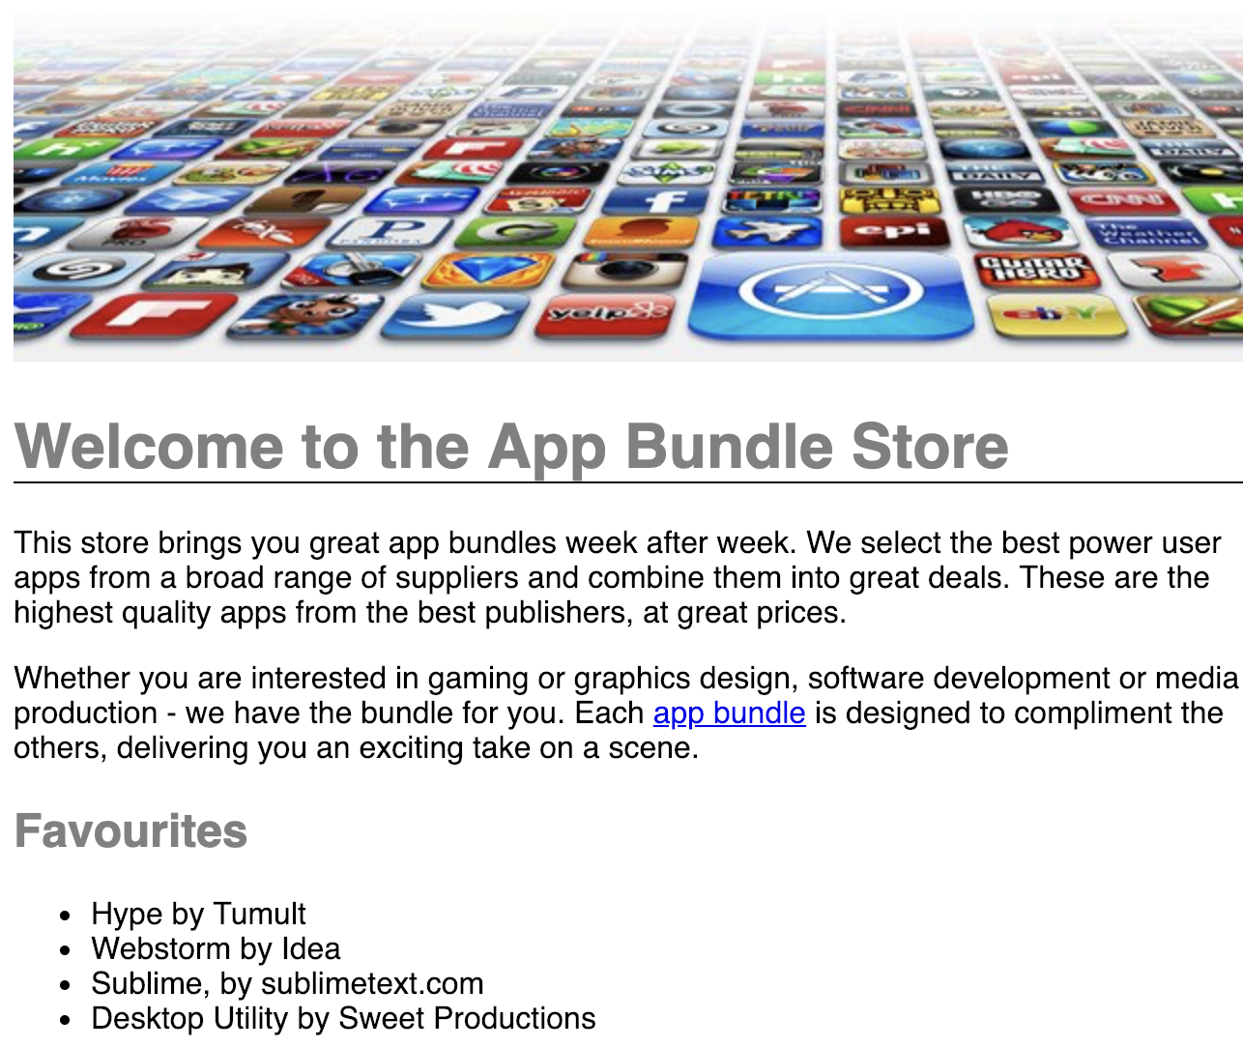
Hyper Text Markup Language
<!DOCTYPE HTML>
<html>
<head>
<title>Bundle APP Store</title>
<link rel="stylesheet" href="style.css">
</head>
<body>
<img src="images/banner.png">
<h1>Welcome to the App Bundle Store</h1>
<p>
This store brings you great app bundles week after week. We select the best power
user apps from a
broad range of suppliers and combine them into great deals. These are the highest
quality apps
from the best publishers, at great prices.
</p>
<p>
Whether you are interested in gaming or graphics design, software development or
media production
- we have the bundle for you. Each <a href="apps.html">app bundle</a> is designed
to compliment the others, delivering you an exciting take on a scene.
</p>
<h2>Favourites</h2>
<ul>
<li>Hype by Tumult</li>
<li>Webstorm by Idea</li>
<li>Sublime, by sublimetext.com</li>
<li>Desktop Utility by Sweet Productions</li>
</ul>
</body>
</html>
HTML tells your browser about the structure of your document:
where the headings are,
where the paragraphs are,
what text needs emphasis, etc
what text needs to linked
what images to be displayed
Given this information, browsers have built-in default rules for how to display each of these elements.
This information is conveyed using “Tags”, this denote the intention of the author regarding the structure and display of the document.

Slide 5
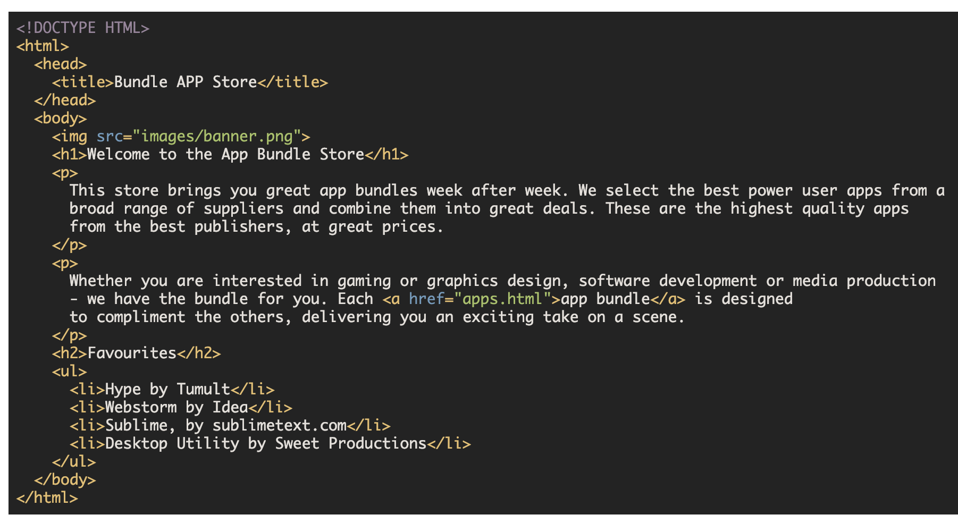
HTML
An HTML document is called a ‘page’
The starting page of a site is called the ‘homepage’
Markup language should only be used for the description of the document structure and not to describe the document presentation
Every HTML document consists of two parts:
Document ‘header’: contains information about the document.
Document ‘body’: contains the content of the document.

Slide 6
HTML Tags (more correctly called Elements)
Starter Tags
Grouped by purpose:
Structural
<html>, <head>, <title>, <body>
Text
Heading
<h1>, <h2>
Text
<p>, <em>
Hypertext
<a>
Image
<img>
Style
<style>
<html>
<head>
<title>
<body>
<h1>
<h2>
<em>
<a>
<img>
<style>

Slide 7
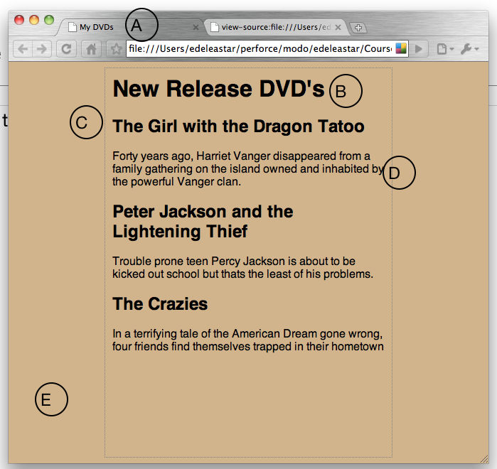

Slide 8
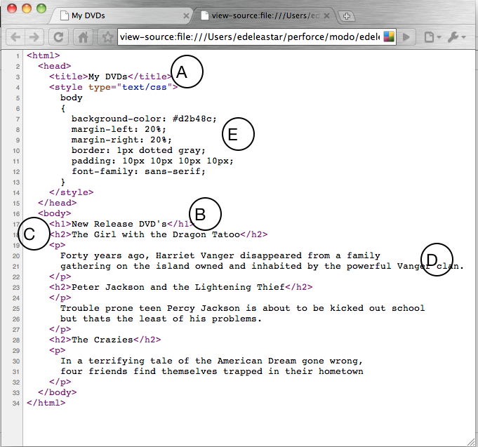
Every word in <> is a Html Element

Slide 10
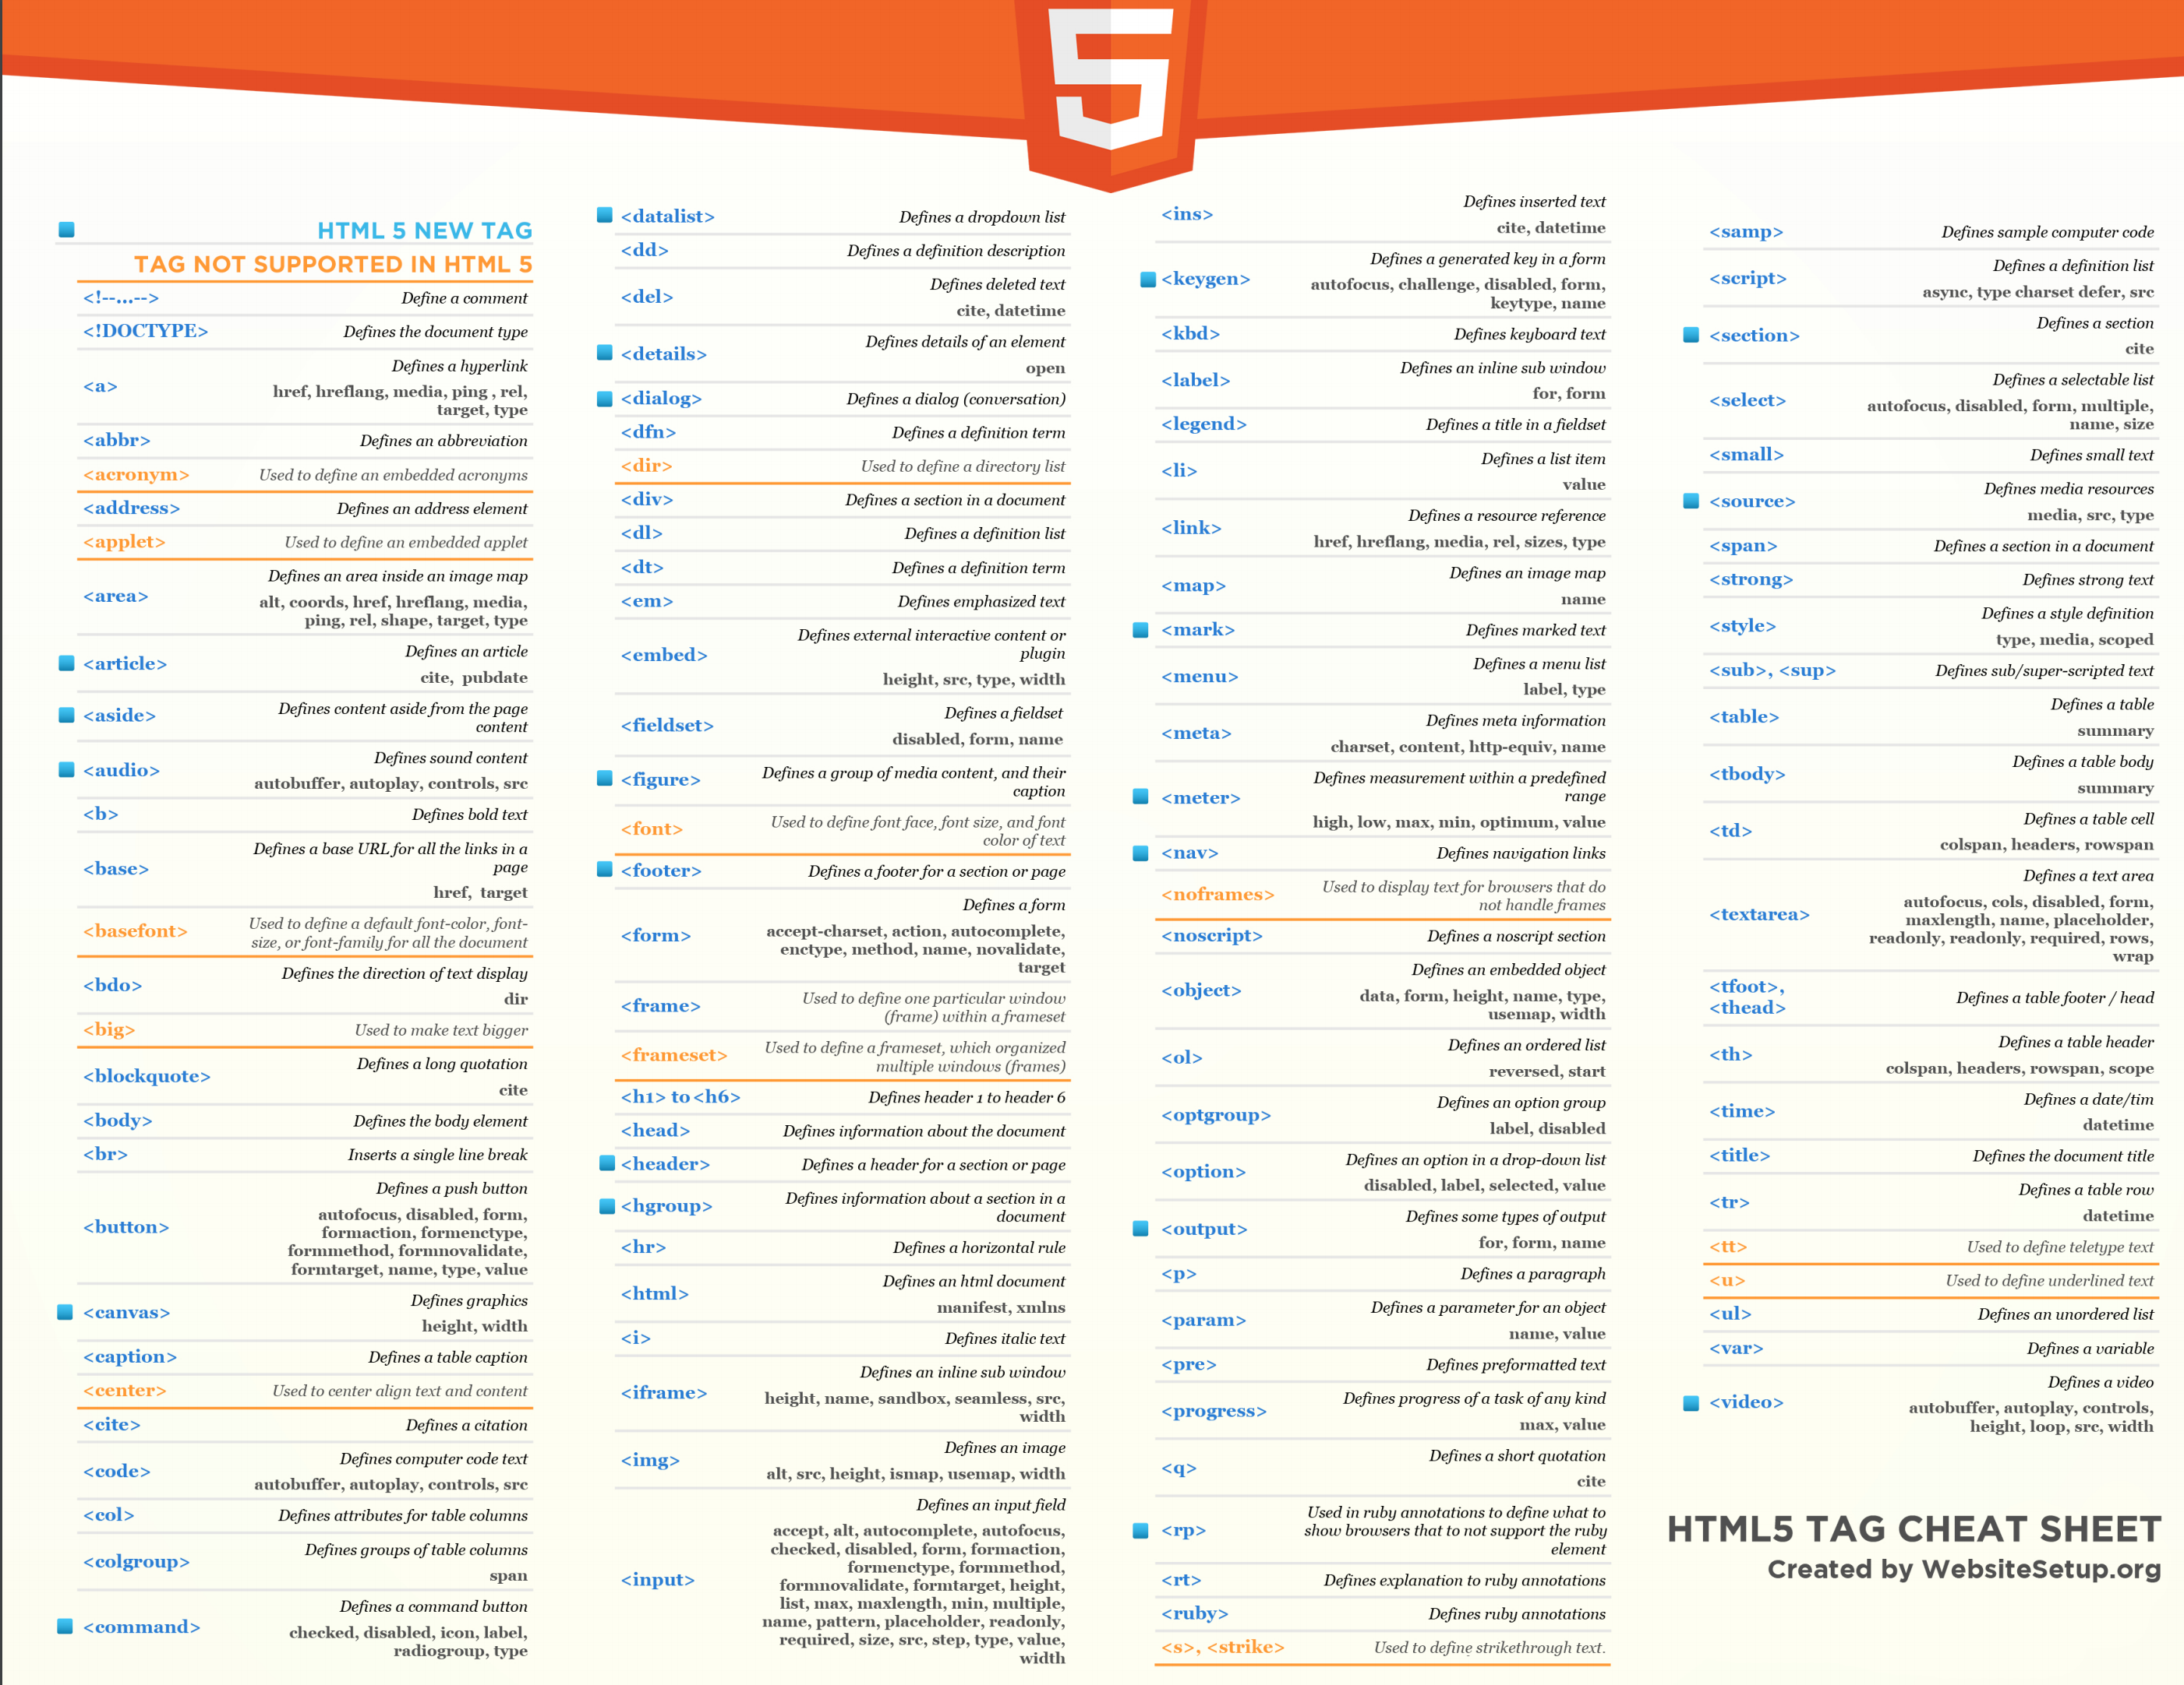

Slide 11
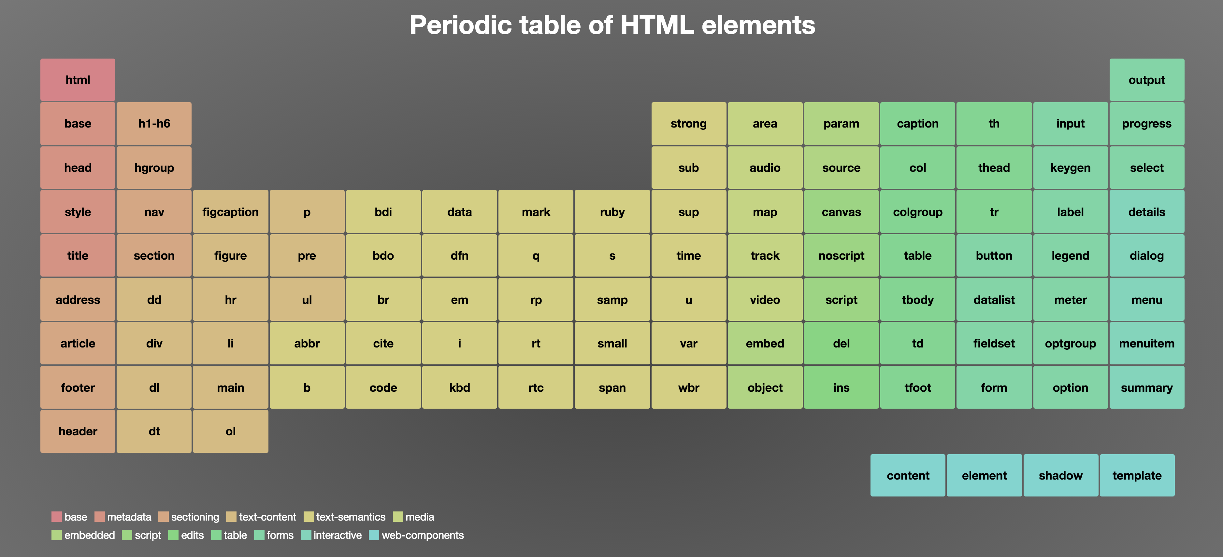
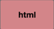

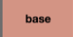
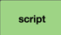
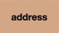


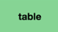
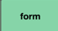
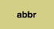
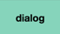


Base
Metadata
Sectioning
Text Content
Text Semantics
Media
Embedded
Script
Edits
Table
Forms
Interactive
Web Components
Major Categories of Elements

